Slide 1
PayPal Mobile Payment Landscape Text Mining and Cluster Analysis using R MSBA 324 – Final Project
Title Page
TEAM MEMBERS: Kanupriya, Miriam o’Callaghan, Reena Sehitya, sweta kumari
Submitted to: Professor Stephan Sorger
Fall 2020

Slide 2
Agenda
Situation (Reena, Kanupriya)
Problem Statement (Miriam)
Model Selection (all team members)
Solution Process (Miriam with all team members)
Research (Miriam with all team members)
Software (Reena and Sweta)
Model Results (Reena, Sweta, Miriam)
Visualization (Reena, Sweta, Kanupriya)
Results Interpretation (Miriam)
Situation Comparison (Sweta and Miriam)
Conclusion (Miriam with all team members)
Recommendations (Miriam with all team members)
Note: the references for each slide are available in APA format both in the notes section of a respective slide and in the bibliography section in the end.

Slide 3
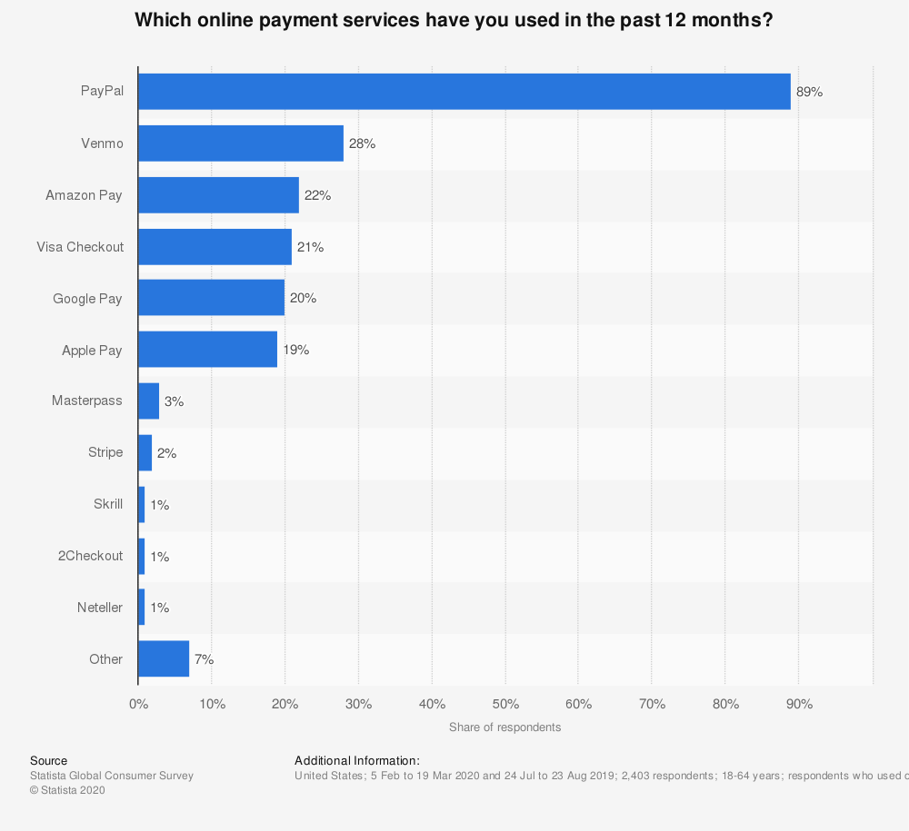
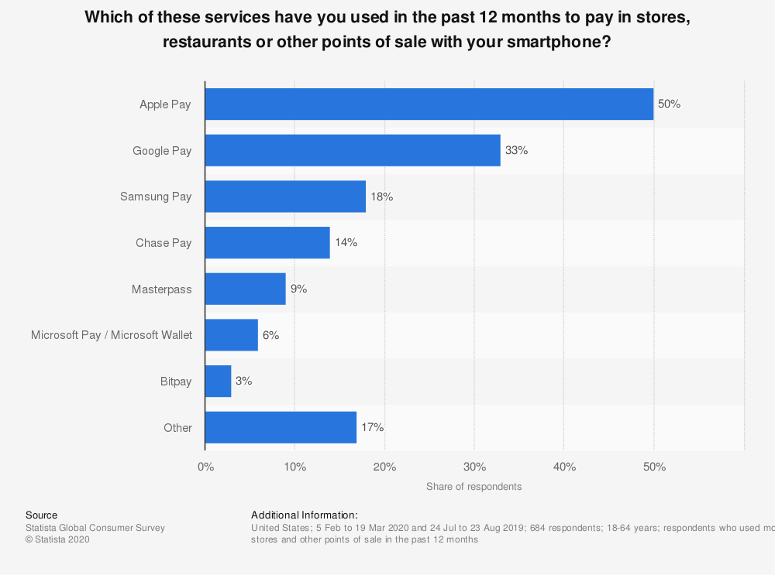
Situation
Brand: PayPal
Symptoms: Despite being a leader in the online payment sector, Paypal is nowhere to be seen in the mobile payment landscape.
Where is PayPal?
Notes:
Online payments by type in the United States 2020. (2020). Statista. https://www.statista.com/forecasts/997125/online-payments-by-type-in-the-us
Online payments by brand in the United States 2020. (2020). Statista. https://www.statista.com/forecasts/997132/online-payments-by-brand-in-the-us

Slide 4
Problem Statement
Problem to Solve: entering the mobile payment market by understanding people’s sentiments about PayPal and knowing customers’ priorities to create more relevant mobile payment service offerings.
Approach: Social media sentiment analysis using text mining, market segmentation through cluster analysis.
Success Criteria: Long term: Increase PayPal’s revenue by 1.24 billion (7% increase) in 1 year.
Short term:
1. Identify social media sentiments for PayPal compared to the sentiments expressed for its competitor Google Pay.
2. Supported by market research, identify top three, high priority customer segments for PayPal’s mobile payment service.
Notes:
PayPal current revenue = 17.77 billion U.S. dollars
PayPal: annual revenue 2019. (2020). Statista. https://www.statista.com/statistics/382619/paypal-annual-revenue/

Slide 5
Model Selection
Models and Rationale – Why we chose these models?
Model 1. Sentiment Analysis using Text Mining – this model will be used to determine the words or phrases that represent people’s sentiments and perceptions about PayPal and its competitor. Using text mining, we will be able to develop a word cloud that will represent the most common positive and negative sentiments people exhibit about the two companies. The model is primarily used for brand comparison purpose.
Model 2. Cluster Analysis (hierarchical agglomerative clustering approach) : this model will be used to determine significant groups of customers that PayPal should focus on while designing and marketing its mobile payment services. The model is primarily used for customer segmentation purpose. Why hierarchical agglomerative clustering? Please refer to the notes section.
Models are not yet adopted, no other models suitable: we found no evidence by our online research that PayPal is already using these models. Also, only these two models are suitable to find effective solution of our problem - understand people’s sentiments about PayPal and creating customer segments by identifying their priorities to for mobile payments. We cannot apply other models that are used to solve other specific problems (example: regression that is used to make predictions).
Notes:
There are different methods for performing cluster analysis, but we chose hierarchical agglomerative clustering approach since its algorithm allows us to choose the number of clusters we want to create. The resulting clusters are displayed in a hierarchical tree called a dendrogram. This way, the algorithm produces a clear graphical depiction of the clusters that we can understand and interpret easily. With this algorithm, we can create decision trees as well as category hierarchies for our business. This is a very effective method for tasks such as customer segmentation.

Slide 6
Solution Process
To make important recommendations for PayPal as a team of consultants, we will go through this ten-step process.
Conduct background research, Collect Twitter data for PayPal and its competitor Google Pay, Perform Sentiment Analysis for PayPal and Google Pay, Collect market data, Execute cluster analysis to identify potential clusters/ segments, Identify segments and interpret meaning of clusters/ segments, Compare clusters to market research, Situation comparison using sentiment analysis and compare PayPal against Goggle Pay, Conclusion and recommendations
1. Conduct background research
2. Collect sentiment data from Twitter for PayPal and its competitor - Google Pay
3. Perform sentiment analysis for PayPal and Google Pay
4. Collect market data with a survey
5. Execute cluster analysis
6. Identify segments and interpret the potential clusters
7. Compare clusters to market research
8. Situation analysis PayPal and Google Pay
9. Concluding the research
10. Make recommendations

Slide 7
Research
How the data was gathered; the sources that we used and why we believe that they are valid.
Background Research Data : most of the data for background research is collected from statista.com which is a well-known market and consumer data company. Harvard Business School library recommends Statista for research. Many renowned research organizations and universities are using Statista and that’s why we believe it is a valid and credible source of data.
Sentiment Analysis and Text Mining Data: we scraped data directly from Twitter for text mining and sentiment analysis. To do that, we developed a developer account on Twitter and scraped the data we wanted. It is a first-hand, primary data directly coming from Twitter and therefore we believe it is highly credible.
Cluster Analysis Data: we collected this data through a market survey. We created our own questionnaire and collected responses using the Google survey tool. We also tested our questionnaire instrument on the sample of 15 respondents to evaluate its validity. It was able to accurately collect the data that we wanted for this study. The details of the questionnaire are discussed in the upcoming sections. It is a first-hand, primary data coming directly from the respondents and therefore we believe it is highly valid and credible data that can be used for this analysis.
Situation Comparison Data: part of this data is scraped directly from Twitter. It is a first-hand, primary data directly coming from Twitter and therefore we believe it is highly credible. We also used information available at SimilarTech, and Statista websites for comparing PayPal vs. Google Pay. SimilarTech, is a SaaS technology company and its services are used by Google, Facebook, and Amazon. We also used data from Techcrunch, an American online newspaper that publishes news on high tech topics. In both academic and industry research, these sources are considered as valid and credible.
Notes:
Library, H. B. (n.d.). Statista | Statistia | Baker Library | Bloomberg Center | Harvard Business School. Retrieved December 3, 2020, from https://www.library.hbs.edu/Find/Databases/Statista
About SimilarTech. (n.d.). https://www.similartech.com/about

Slide 8
Software
R programming language (R Console in PC and Mac) is used to analyze and visualize PayPal and Google Pay data.
Libraries used for text mining and sentiment analysis:
base64enc, twitteR, ROAuth, RCurl, tm, SnowballC, syuzhet, glue, ggplot2, ggpubr, tidyverse, tidytext, rtweet, ggmap, stringr, wordcloud, lubridate, data.table, reshape2

Slide 9

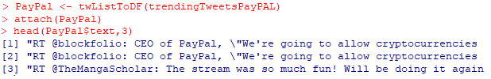
Software
Sentiment Analysis using Text Mining : Collecting Twitter data for PayPal
To collect the tweets, the first step is to set up the authentication (API keys, token, etc.) and extract the data with the help of Twitter and R.
The next step is to extract the data from Twitter and import it in data frame format into R.

Slide 10

Software
Sentiment Analysis using Text Mining : Data Cleaning
Number of Rows and Columns in data frame
The next step is to clean the text data. The code below is used to remove http elements and punctuations, convert text to lowercase, add id for each tweet, and remove stop words.

Slide 11
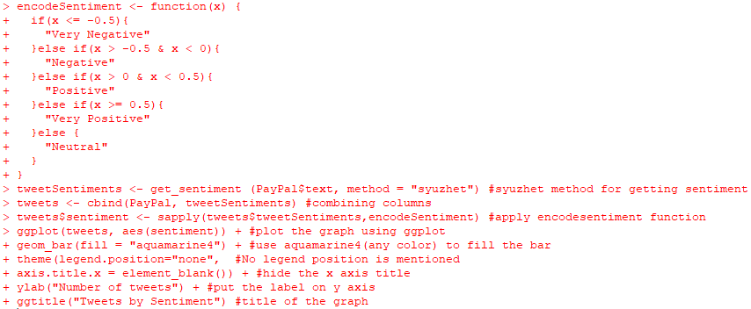
Software
Sentiment Analysis using Text Mining : Sentiments for PayPal
To understand and visualize the sentiments for PayPal mobile payment, thid code is used. It displays the sentiments in five categories: “Very Positive”, “Positive”, “Neutral”, “Very Negative”, “Negative”.

Slide 12
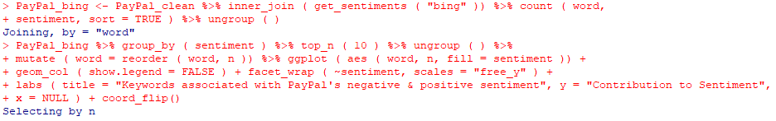

Software
Sentiment Analysis using Text Mining : Frequently used words and Word Cloud for PayPal
To understand how frequently the positive and negative terms are used for PayPal, we used this code and created a bar chart for positive and negative words.
We then created a word cloud dividing into positive and negative sentiment.

Slide 13
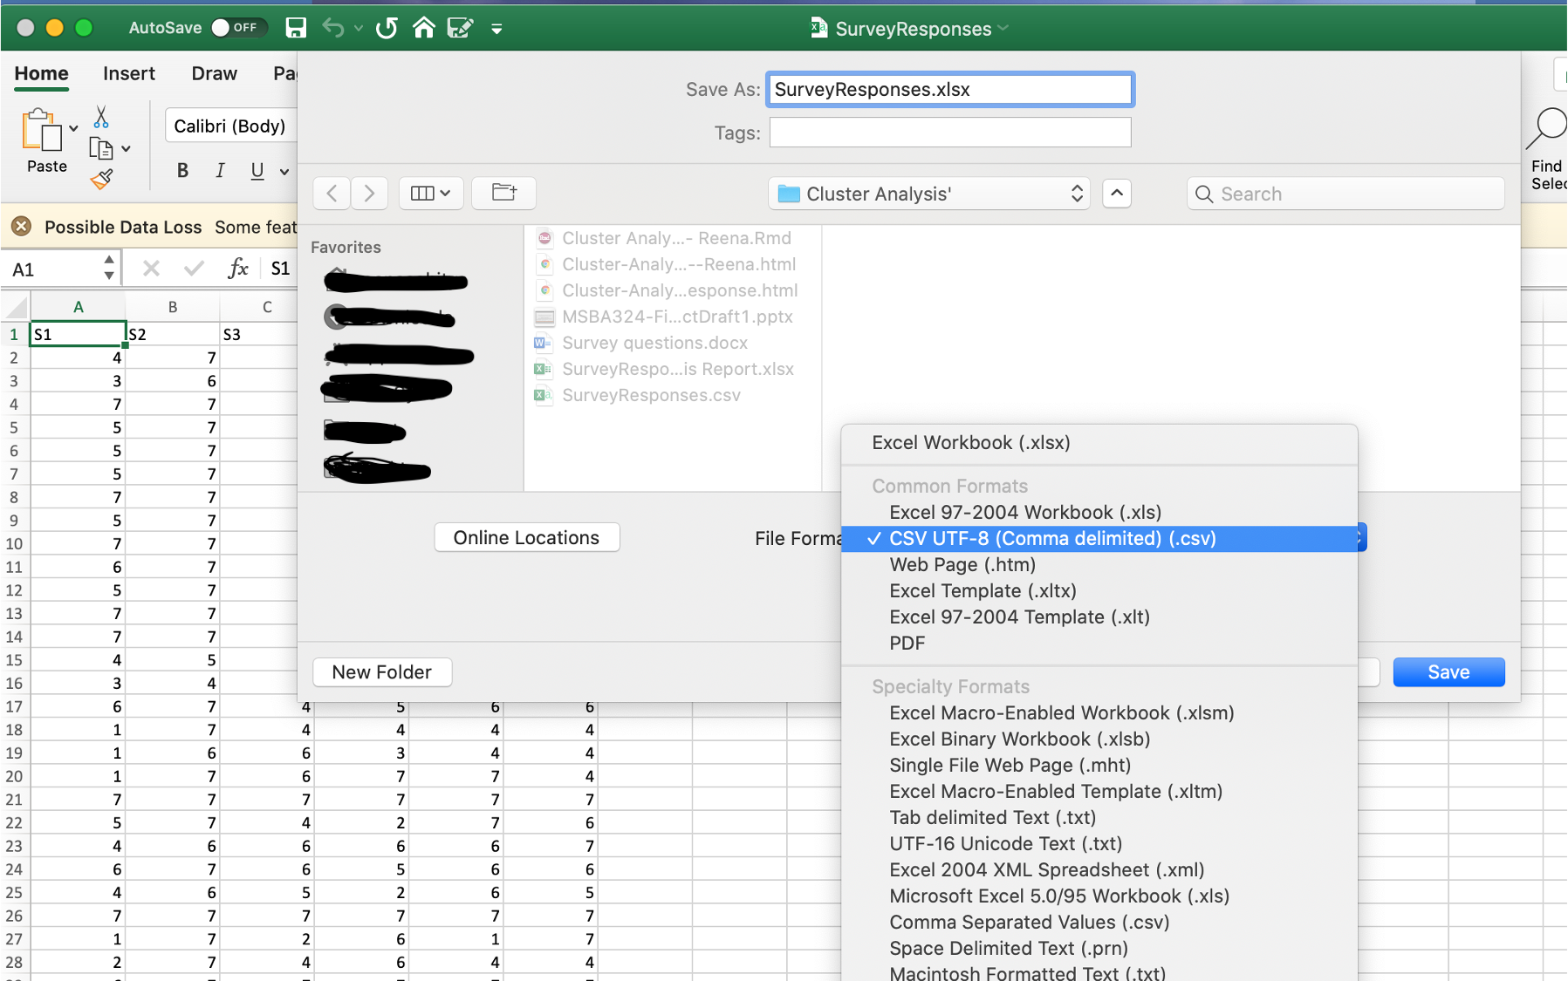
Software
Cluster analysis for Market Segmentation : Data Collected through Market Survey
Our first step was to convert survey data from Microsoft Excel to Comma Separated Values (csv) format.

Slide 14
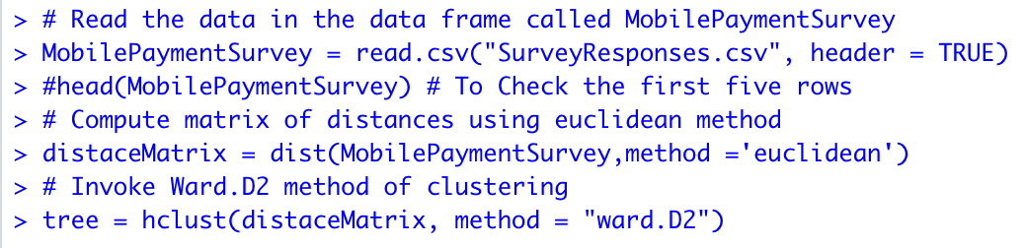
Software
Cluster analysis for Market Segmentation : Data Preparation (used R Console with Mac OS, snapshots look different)
Next, we read the data into the data frame called MobilePaymentSurvey then computed matrix of distances using Euclidean method and invoked Ward.D2 method of clustering

Slide 15


Software
Cluster analysis for Market Segmentation : Agglomerative Hierarchical Cluster Dendrogram
In order to view potential segments, we plotted cluster dendrogram.
In order to identify 4 clusters, we cut the tree vertically and added red boxed using hclust function.

Slide 16
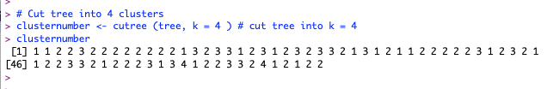
Software
Cluster analysis for Market Segmentation : Members in Each Cluster
We ran the code to see which respondent showed preferences in which cluster- 1, 2, 3, 4

Slide 17
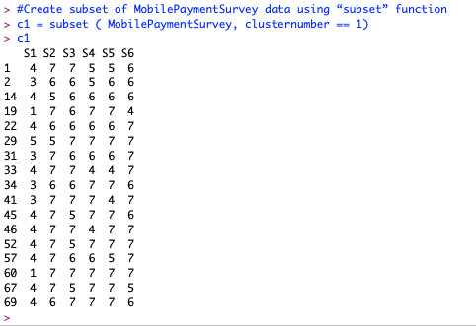
Software
Cluster analysis for Market Segmentation : Cluster Members Analysis
Next, we created the subset of MobilePaymentSurvey data using “subset” function for each cluster.
Members for cluster 1

Slide 18
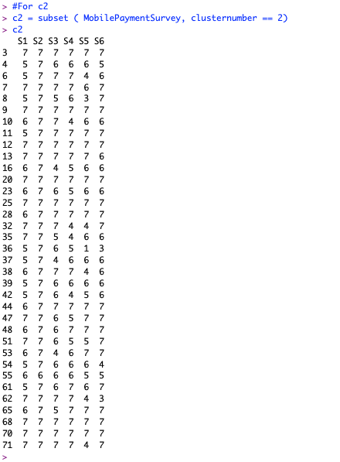
Software
Cluster analysis for Market Segmentation : Cluster Members Analysis
Members for cluster 2: Consisting of major portion of total respondents and require our attention

Slide 19
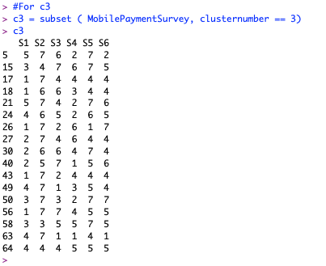
Software
Cluster analysis for Market Segmentation : Cluster Members Analysis
Members for cluster 3 – there are fewer respondents than cluster 2 and cluster 1 falling into this cluster

Slide 20
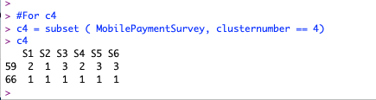
Software
Cluster analysis for Market Segmentation : Cluster Members Analysis
Members for cluster 4 – there are only 2 respondents falling into this cluster and probably doesn’t require much of our attention while making marketing decisions.

Slide 21
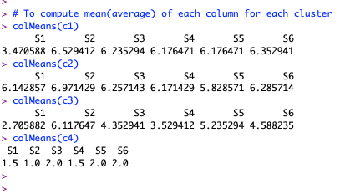
Software
Cluster analysis for Market Segmentation : Cluster Averages
In order to gain insights, we ran the code colMeans() function to get the summary statistics of each column for all four clusters - c1, c2, c3, c4

Slide 22
Model Results
Results – Sentiment Analysis and Word Cloud
The top 5 terms used to express negative sentiments are "bust", “emergency", “hate", “vomiting", “sad“.
The top 5 terms used to express positive sentiments are “like", “reputation", “appreciated", “enough", “thank“.
A few strong negative words such as “scam”, “fraud”, “cheap”, “debt” are used in the tweets to exhibit anger or complaints against PayPal.
People are also talking about the crypto currency, bitcoin in relation to PayPal. This points at the money market trend that is shifting more towards the digital currency instruments.
The highest number of sentiments are expressed in “very positive” category whereas the smallest number is expressed in the “negative” category.

Slide 23
Model Results
Results - Cluster Analysis
Table 1 summarizes the results of cluster analysis in form of mean values for each response under the four clusters. Table 2 consists of the details of all question statements that respondents responded to.
Table 1
Cluster | S1 | S2 | S3 | S4 | S5 | S6
1 | 3.47 | 6.53 | 6.24 | 6.18 | 6.18 | 6.35
2 | 6.14 | 6.97 | 6.26 | 6.17 | 5.83 | 6.29
3 | 2.71 | 6.12 | 4.35 | 3.53 | 5.24 | 4.59
4 | 1.50 | 1.00 | 2.00 | 1.50 | 2.00 | 2.00
In table 1, significantly high and low rated responses are turned bold.
Table 2
Survey statements
S1 | I prefer to use a mobile device for all my in-store purchases. (eg: Apple pay supported by iPhone)
S2 | For mobile payments, I value safety of transactions the most.
S3 | For mobile payments, convenience (eg: one-touch pay, QR code) is my priority.
S4 | For mobile payments, saving money (low or no transaction fee) is my priority.
S5 | For mobile payments, I prefer to receive the best deals and offers from merchants
S6 | For mobile payments, excellent customer service (eg: call center support) is my priority.
More details of these results are available in the notes section.
A 7-point Likert Scale was used (7 “Strongly Agree” to 1 “Strongly disagree”.
Notes:
Cluster 1 rated S2, S3, S4, S5, and S6 the highest. They prefer safety, convenience, saving, rewards, and excellent customer service.
Cluster 2 rated S1, S2, S3, S4, S5, and S6 the highest. They are the highest users of mobile payment services and prefer safety, convenience, saving, rewards, and excellent customer service.
Cluster 3 rated S2 and S5 the highest. They prefer safety and rewards.
Cluster 4 rated all statements significantly low.
Cluster 4 doesn’t need our attention and therefore will be excluded from our final cluster set which will include only 3 clusters.

Slide 24
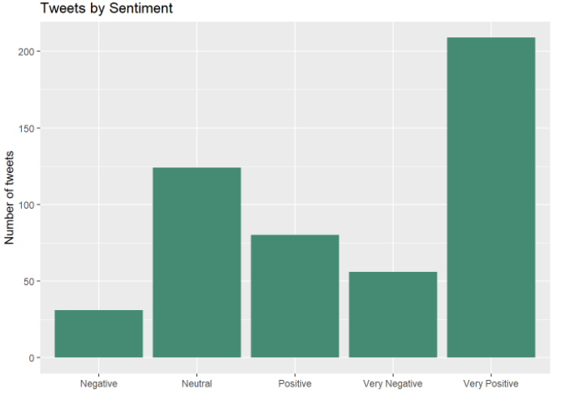
Visualization
Sentiment Analysis - PayPal
Tweets by Sentiment (Very Negative, Negative, Neutral, Positive, Very Positive)
Figure 1

Slide 25
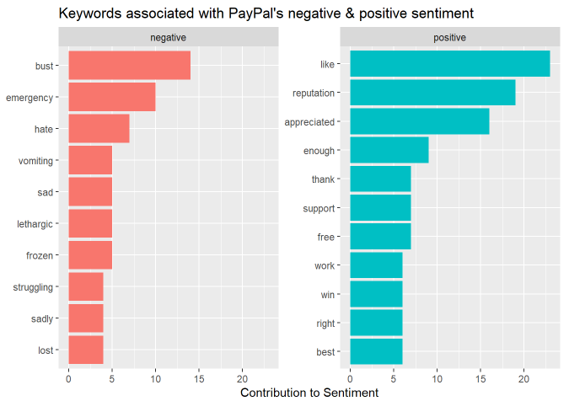
Visualization
Sentiment Analysis-PayPal
Most frequently negative words used for PayPal
Most frequently Positive words used for PayPal
Figure 2

Slide 26
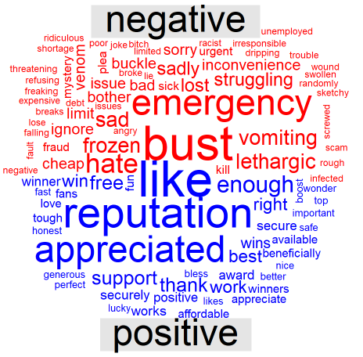
Visualization
Sentiment Analysis-PayPal
Word Cloud with negative and positive words for PayPal
Figure 3

Slide 27
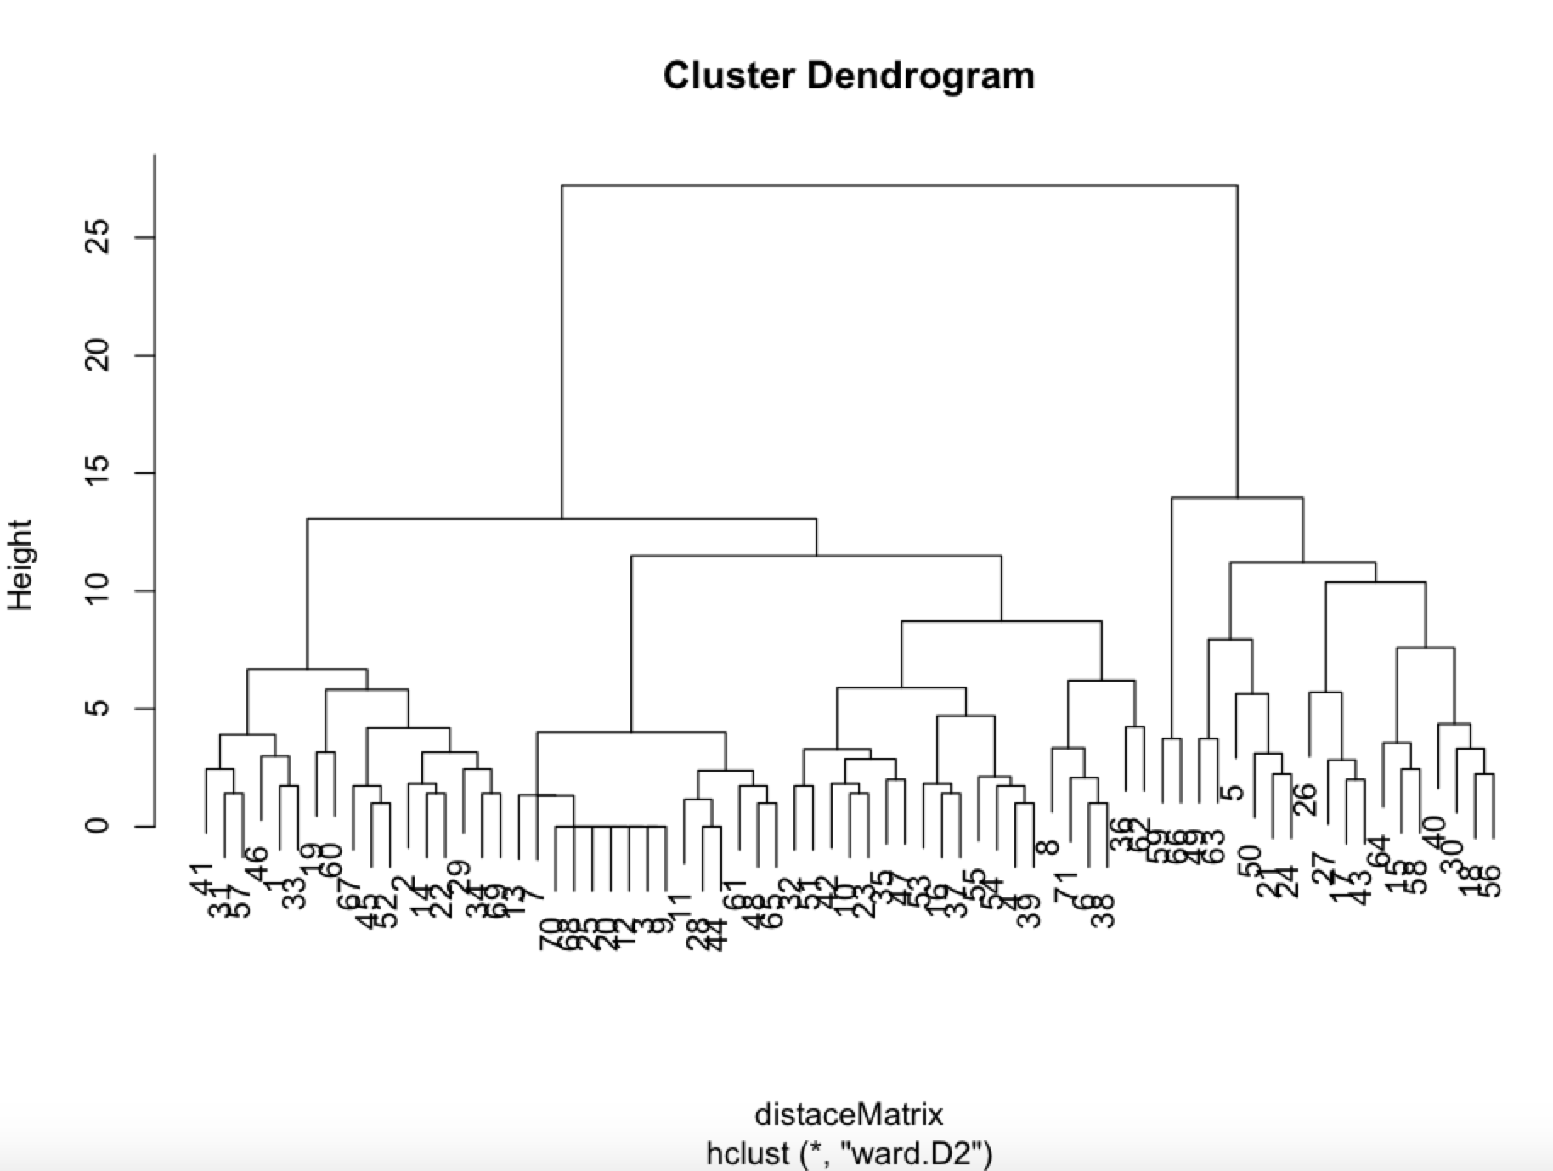
Visualization
Cluster Analysis: Cluster Dendrogram
Figure 4

Slide 28
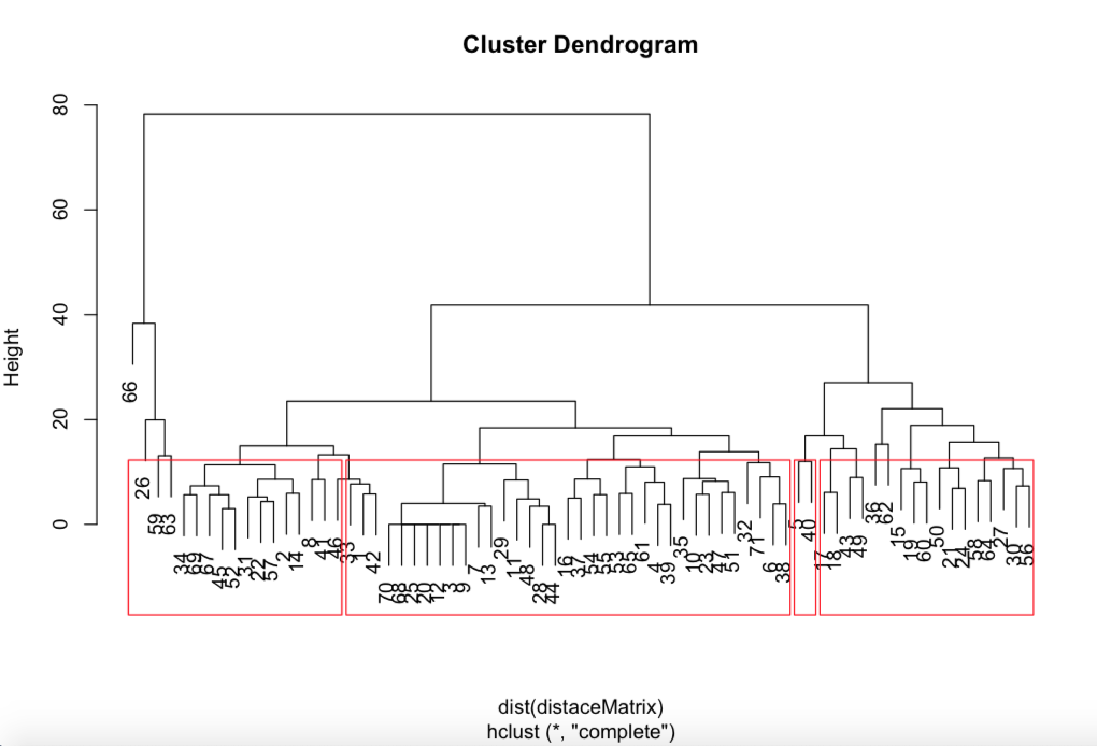
Visualization
Cluster Analysis: Cluster Dendrogram
Potential clusters in dendrogram
Figure 5

Slide 29
Result Interpretation
Sentiment Analysis Result Interpretation:
Overall, people exhibited more positive sentiments as compared to the negative and neutral sentiments. Collectively, number of “very positive” and “positive” tweets are more than other sentiments. The number of neutral sentiments is also significant (second highest). It can be interpreted as the presence of expressions that might not be associated with any sentiments or preferences for PayPal.
We identified a significant frequency of negative and very negative emotion expressions (figures 1 and 3 - sentiment analysis bar chart and word cloud). The frequency is not insignificant, it is towards the higher side.
Negative words for PayPal are used more frequently than positive words in the Word Cloud which is a little alarming. The top three words – like, reputation, and appreciated seems positive but cannot be considered as very positive (intense positive emotions such as expression of joy and ecstasy). On the other hand, the top negative words are extremely negative – bust, emergency, and hate. People are expressing moderately positive and extremely negative emotions for PayPal on Twitter.
Cluster Analysis Result interpretation:
Four clusters are identified. Cluster 2 consists the major portion of total respondents and respondents in this cluster rated all statements in the questionnaire very high. They are the highest users of mobile payment services and prefer safety, convenience, saving, rewards, and excellent customer service.
Cluster 1 is second largest cluster with 5 high ratings. They prefer safety, convenience, saving, rewards, and excellent customer service.
Cluster 3 rated only two statements high. They prefer safety and rewards and don’t care about other features.
Cluster 4 is the smallest cluster with only two respondents with very low ratings on all the statements in the questionnaire. This cluster will be excluded from our final cluster set which will include only 3 clusters.

Slide 30
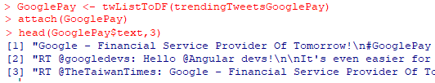
Situation Comparison – Google Pay
Sentiment Analysis using Text Mining : Data Collection for Google Pay
The first step is to extract Google Pay data from Twitter and import it in data frame format into R
The next step is to clean the text data. The following code used to remove http elements and punctuation, convert text to lowercase, add id for each tweet, remove stop words.

Slide 31

Situation Comparison – Google Pay
Sentiment Analysis using Text Mining : Data Cleaning
Number of Rows and Columns in data frame
The next step is to clean the text data. Below code is used to remove http elements and punctuation, convert text to lowercase, add id for each tweet, remove stop words.

Slide 32
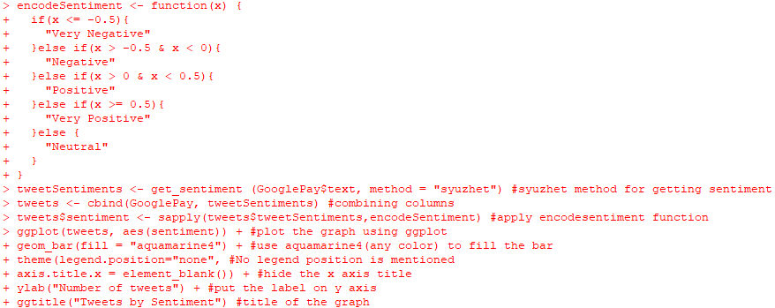
Situation Comparison – Google Pay
Sentiment Analysis using Text Mining : Sentiments for Google Pay
To understand and visualize the sentiments for PayPal mobile payment, the below code is used. It displays the sentiments in five categories: “Very Positive”, “Positive”, “Neutral”, “Very Negative”, “Negative”.

Slide 33
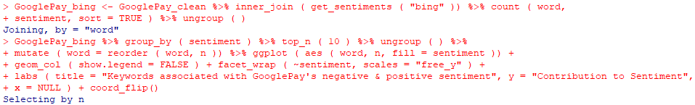

Situation Comparison – Google Pay
Sentiment Analysis using Text Mining : most frequent positive and negative sentiments expressed for Google Pay and the Word Cloud
To understand how frequently the positive and negative terms are used for Google Pay, we used code and created a bar chart showing positive and negative sentiments frequency.
Code for word cloud classifying sentiments into positive and negative.

Slide 34
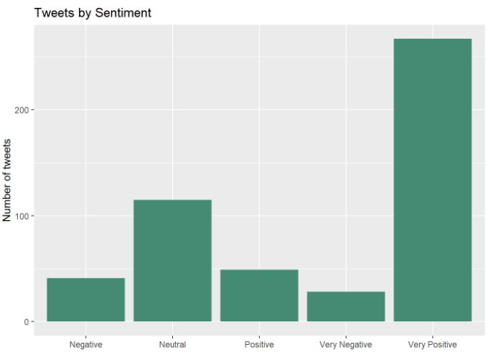
Visualization
Sentiment Analysis – Google Pay
Tweets by Sentiment (Very Negative, Negative, Neutral, Positive, Very Positive)
Figure 6

Slide 35
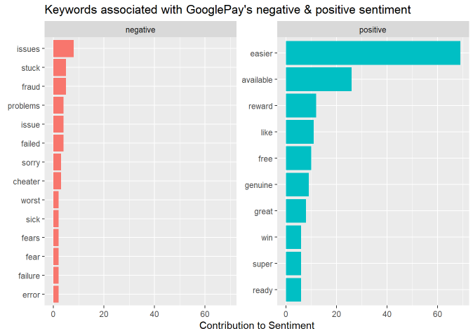
Visualization
Sentiment Analysis – Google Pay
Most frequently negative words used for Google Pay
Most frequently Positive words used for Google Pay
Figure 7

Slide 36
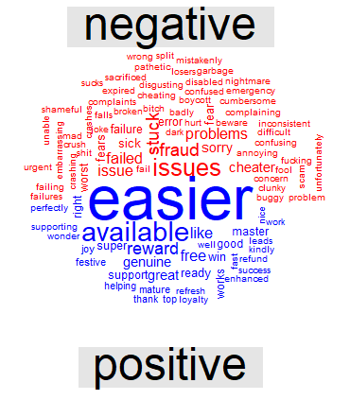
Visualization
Sentiment Analysis – Google Pay
Word Cloud with negative and positive words for Google Pay
Figure 8

Slide 37
Google Pay - Model Results
Sentiment Analysis for Google Pay
People exhibited more positive sentiments as compared to the negative and neutral sentiments. Collectively, number of “very positive” and “positive” tweets are more than other sentiments. The number of neutral sentiments is also significant (second highest).
The top 5 terms used to express negative sentiments are “issue", “stuck", “fraud", “problem", “failed“.
The top 5 terms used to express positive sentiments are “easier", “available", “record", “like", “free“.
The negative words are more in number than positive words in the Word Cloud.
A few more frequent negative words such as “stuck”, “inconsistent”, “fraud”, “annoying” are used in the tweets to show anger or complaints against Google Pay.
Other than all the positive and negative words, people also used some other words in relation to Google Pay, they are - India, tickets, and other places to visit such as goa.

Slide 38
Situation Comparison – Brand and Performance Comparison
Comparison Criteria | PayPal | Google Pay
1. Primary service – value proposition | PayPal services enable companies and individuals to send money and to accept payments without revealing any financial details. | Google Pay is mostly used for making purchases at thousands of online stores and businesses.
2. Market share by top websites | PayPal is leading in Top 10K Sites, Top 100K Sites, Top 1M Sites and The Entire Web. Total number of websites using PayPal - 1,322,386 | Despite its recent growth, Google Pay is still behind PayPal in all market share segments. Total number of websites using Google Pay - 63,748
3. Websites categories | PayPal has better usage coverage in more website categories. Including Computers Electronics & Technology, Lifestyle, Arts & Entertainment, Games and 20 other categories. | Google Pay hasn't got a lead over PayPal in any website category.
4. Geography | PayPal is leading in most countries, including United States, United Kingdom, Germany, France and 158 other countries. | Google Pay hasn't got a lead over PayPal in any country.
5. Number of active users worldwide | PayPal has 361 million active user accounts. | Google Pay is expected to reach 100 million user accounts in 2020.
6. Mobile payment priority | PayPal is not one of the top priorities for mobile payments. | Google Pay ranked as number 2 for most preferred mobile payment services.
Notes:
Statista. (2020). PayPal-Statistics and Facts. Statista. https://www.statista.com/topics/2411/paypal/
Statista. (2020). Digital wallet users by company. Statista. https://www.statista.com/statistics/722213/user-base-of-leading-digital-wallets-nfc/
Google Pay VS PayPal - Payment Technologies Market Share Comparison. (n.d.). SimilarTech. https://www.similartech.com/compare/google-pay-vs-paypal
Online payments by brand in the United States 2020. (2020). Statista. https://www.statista.com/forecasts/997132/online-payments-by-brand-in-the-us

Slide 39
Situation Comparison - using Sentiment Analysis
For Google Pay, people exhibited more positive sentiments as compared to the negative and neutral sentiments. Collectively, number of “very positive” and “positive” tweets are more than other sentiments. The number of neutral sentiments is also significant (second highest). This pattern is quite similar to what we saw in PayPal analysis except for the frequency of negative sentiments which was significantly higher in PayPal’s case.
The top 5 terms used to express negative sentiments about Google Pay are “issue", “stuck", “fraud", “problem", “failed“. Comparatively, top negative expressions used for PayPal are stronger - "bust", “emergency", “hate", “vomiting", and “sad“.
The top 5 terms used to express positive sentiments for Google Pay are “easier", “available", “record", “like", “free“. For PayPal, they were - “like", “reputation", “appreciated", “enough", “thank“. They are quite similar.
Just like PayPal, the number of negative words for Google Pay are more than positive words in the Word Cloud.
As compared to PayPal, the frequency of negative emotions is significantly low for Google Pay. This shows that people are expressing more negative sentiments for PayPal compared to Google Pay.
Where for PayPal, people used crypto currency and bitcoin terms very frequently, in relation to Google Pay, they used these words frequently - India, tickets, and goa.

Slide 40
Situation Comparison – Clustering and Customer Segmentation
How Google Pay in the same situation managed to solve their problem using a similar method
In this research, we performed cluster analysis to identify key customer segments for PayPal to help the company enter mobile payment market successfully. Google Pay has used a similar approach to segment its mobile payment customers into three distinct categories – 1. those who prefer speed, 2. those who prefer rewards and save money, 3. those who want to manage their money effectively by keeping track of their spending.
To attract the customers in these three segments, Google Pay has recently launched ‘Google Pay app’ to combine three important features. These three features are three tabs in the app. Google director of product management Josh Woodward describes this as:
“One is the ability to pay friends and businesses really fast. The second is to explore offers and rewards, so you can save money at shops. And the third is getting insights about your spending so you can stay on top of your money.”
Since Google Pay is ranked number 2 for mobile payments and using this approach, we believe that creating customer clusters and segments based upon their priorities will help PayPal to gain mobile payment market share successfully.
Notes:
Google Pay gets a major redesign. (2020). TechCrunch. https://social.techcrunch.com/2020/11/18/google-pay-gets-a-major-redesign/

Slide 41
Conclusion
Model 1, sentiment analysis is focused on studying what sentiments people exhibit about PayPal on social media. This is part of our brand monitoring strategy. We found that in most part, people express positive emotions about PayPal. However, a significant number of people also expressed negative and very negative sentiments along with extremely strong negative words. This is not a good sign for PayPal.
Model 2, cluster analysis helped us to identify three actionable market segments for PayPal. Cluster 1 and 2 have shown quite similar priorities such as safety, convenience, saving money, best offers/deals, and customer service. Cluster 3 only cared about the safety of the transactions and receiving best offers/deals. Based upon our study of these clusters, we conclude that cluster 2 is going to be PayPal’s Priority 1 customer segment, cluster 2 will be Priority 2, and cluster 3 will be Priority 3 customer segment. We decided to exclude cluster 4 from our final set of segments due to the small number of respondents in the cluster and not highly significant responses.

Slide 42
Conclusion
We compared PayPal and Google Pay at three levels – brand and business comparison, social media sentiment comparison, and customer segment comparison. Overall, people have expressed more negative sentiments for PayPal as compared to Google Pay. PayPal’s brand and business, globally, seems to be more successful but it is struggling to enter mobile payment market. We also found that Google pay has also adopted similar customer segmentation approach (segmenting customers based upon their priorities) and achieved great success in the market. Our market research for clustering is also based upon identifying people’s priorities for mobile payments. These clusters helped us to finally create three actionable market segments for PayPal.
With our study, we achieved our success criteria. Long term: PayPal will use these segments to effectively design and market its services which will help the company to increase its revenue by 1.24 billion (7% increase) in 1 year. Short term: we successfully identified social media sentiments for PayPal compared to the sentiments expressed for its competitor Google Pay. Supported by market research, we also identified top three, high priority customer segments for PayPal’s mobile payment service.

Slide 43
Recommendations
Very high expression of negative emotions is not good for company’s image and overall bottom-line. PayPal should improve its reputation by launching a major social media marketing campaign in January 2021. The theme of the campaign - transaction safety, convenience, and rewards.
Through our market research we identified the top three priorities for mobile payments – safety, convenience, and rewards (best offers/deals). Create an app to combine these three features into three tabs in the app. Google Pay’s app is quite similar to this.
The app should have built-in authentication, transaction encryption, and fraud protection systems. Allow the app users to choose the privacy settings that are right for them.
For convenience allow users to keep credit cards, debit cards, transit passes, and more on their phone for quick, and easy access.
A significant number of people seem to like rewards. Offer them more cashback rewards when they activate offers from their favorite businesses and make everyday purchases using PayPal’s mobile payment app.
Advertise PayPal’s new app on Facebook, Twitter, and YouTube to reach 50 million users by June 2021. By December 2021, PayPal’s new app will have 35 million new subscribers which will help the company to increase its revenue by 1.24 billion.

Slide 44
Bibliography
Online payments by type in the United States 2020. (2020). Statista. https://www.statista.com/forecasts/997125/online-payments-by-type-in-the-us
Online payments by brand in the United States 2020. (2020). Statista. https://www.statista.com/forecasts/997132/online-payments-by-brand-in-the-us
PayPal: annual revenue 2019. (2020). Statista. https://www.statista.com/statistics/382619/paypal-annual-revenue/
Library, H. B. (n.d.). Statista | Statistia | Baker Library | Bloomberg Center | Harvard Business School. Retrieved December 3, 2020, from https://www.library.hbs.edu/Find/Databases/Statista
About SimilarTech. (n.d.). https://www.similartech.com/about
Statista. (2020). PayPal-Statistics and Facts. Statista. https://www.statista.com/topics/2411/paypal/
Statista. (2020). Digital wallet users by company. Statista. https://www.statista.com/statistics/722213/user-base-of-leading-digital-wallets-nfc/
Google Pay VS PayPal - Payment Technologies Market Share Comparison. (n.d.). SimilarTech. https://www.similartech.com/compare/google-pay-vs-paypal
Online payments by brand in the United States 2020. (2020). Statista. https://www.statista.com/forecasts/997132/online-payments-by-brand-in-the-us
Google Pay gets a major redesign. (2020). TechCrunch. https://social.techcrunch.com/2020/11/18/google-pay-gets-a-major-redesign/

